Slide 1
Database Management
Systems

Slide 2
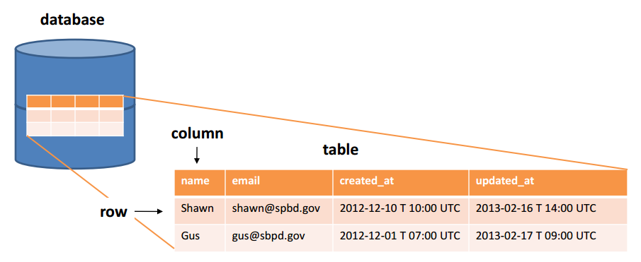
Data Independence in Relational Databases

Slide 3
Contents:
Data Model
Database Language

Slide 4
Describing Data: Data Models
A data model is a collection of concepts for describing data.
A schema is a description of a particular collection of data, using a given data model.
The relational model of data is the most widely used model today.
Main concept: relation, basically a table with rows and columns.
Every relation has a schema, which describes the columns (fields, attributes) and keys.
Notes:
‹#›
5

Slide 5
Example: University Database
Schema:
Students(sid text, name text, login text, age integer, gpa float)
Courses(cid text, cname text, credits integer)
Enrolled(sid text, cid text, grade text)
Notes:
‹#›
7

Slide 6
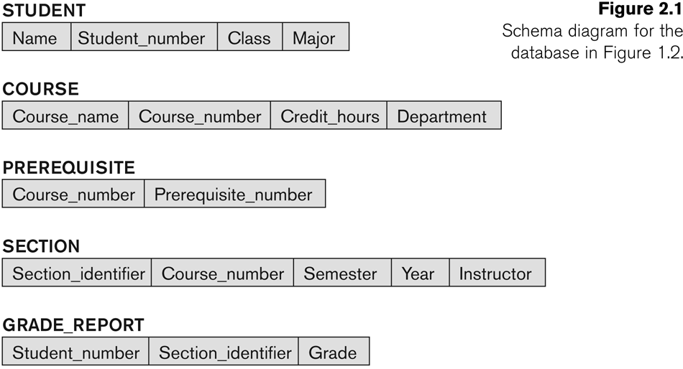
Example of a Database Schema

Slide 7
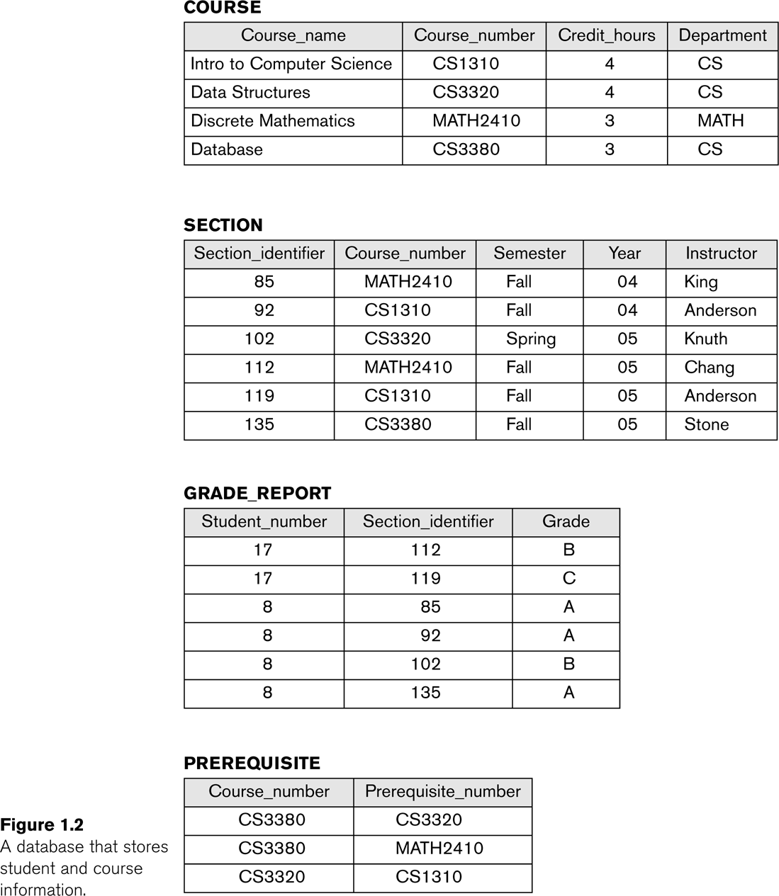
Example of a database state
STUDENT
Name | Student_number | Class | Major
Smith | 17 | 1 | CS
Brown | 8 | 2 | CS

Slide 8



Levels of Abstraction
Users
Views describe how users see the data.
Conceptual schema defines logical structure
Physical schema describes the files and indexes used.
View 1
View 2
View 3
Conceptual Schema
Physical Schema
DB
Notes:
‹#›
6

Slide 9
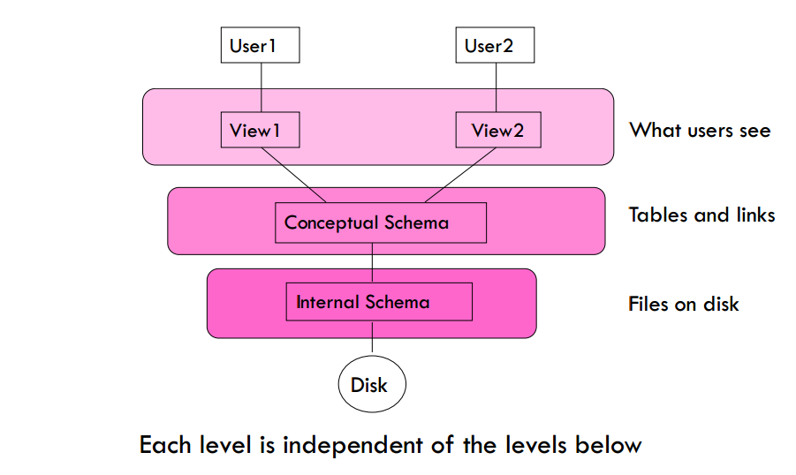
Database Architecture With Views

Slide 10
Data Model
A collection of conceptual tools for describing
Data
Data relationship
Consistency constraints
Provides a way to describe the design of a database at the physical, logical and view level
Four different categories:
Relational Model
Entity-Relationship Model
Object-Based Data Model
Semi structured data model

Slide 11
Relational Model
It uses a collection of tables to represent both data and relationships among those data.
Each table has multiple columns, and each column has a unique name
An example of a record-based model
Database is structured in fixed-format records of several types
Each table contains records of a particular type
Each record type defines a fixed no. of fields, or attributes
Widely used data model and a vast majority of current database systems are based on the relational model.

Slide 12
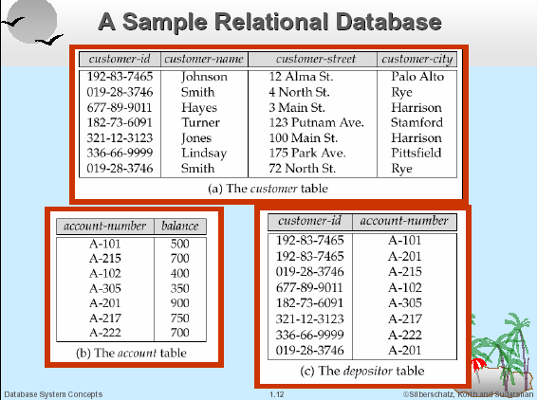
Relational Model

Slide 13
Entity-Relationship Model
Models an enterprise as a collection of entities and relationships
Entity: a “thing” or “object” in the enterprise that is distinguishable from other objects
Relationship: an association among several entities
Widely used in database design
Represented diagrammatically by an entity-relationship diagram

Slide 14
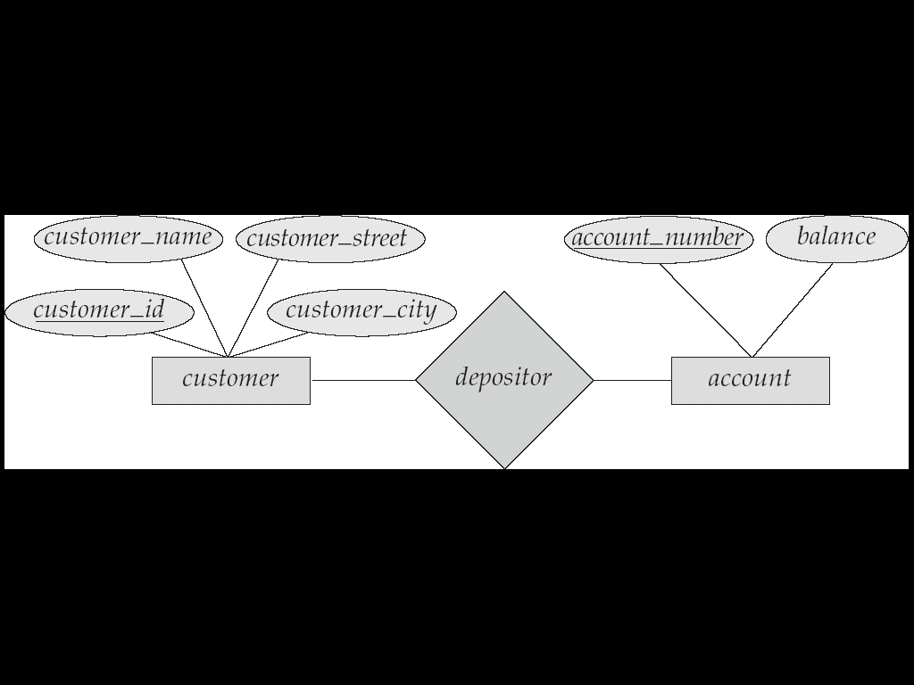
Entity-Relationship Model

Slide 15
DBMS Languages
Data Definition Language (DDL)
Data Manipulation Language (DML)
High-Level or Non-procedural Languages: These include the relational language SQL
May be used in a standalone way or may be embedded in a programming language
Low Level or Procedural Languages:
These must be embedded in a programming language
Slide 1- ‹#›
Notes:
‹#›

Slide 16
Data Manipulation Language (DML)
Language for accessing and manipulating the data organized by the appropriate data model
DML also known as query language
Two classes of languages
Procedural – user specifies what data is required and how to get those data. e.g. Relational Algebra.
Declarative (nonprocedural) – user specifies what data is required without specifying how to get those data. e.g. SQL
Declarative DMLs are usually easier to learn and use than procedural DMLs.

Slide 17
Data Manipulation Language (DML)
The types of accesses are
DML also known as query language
i) The retrieval of information stored in the database - Query
ii) The insertion of new information into the database - insert
iii) The deletion of information from the database - delete
iv) The modification of information stored in the database - update

Slide 18
Data-Definition Language (DDL)
Specify the database schemas
The DDL is also used to specify additional properties of data.
Example
create table account (
account_number char(10),
balance number (12,2)
);
Data definition and data manipulation languages are not two separate language; they simply part of a single database language such as SQL.

Slide 19
Database architecture
A Database Architecture is a representation of DBMS design.
It helps to design, develop, implement, and maintain the database management system.
A DBMS architecture allows dividing the database system into individual components that can be independently modified, changed, replaced, and altered.

Slide 20
Significance of “Tiers”
N-tier architectures have the same components
Presentation
Business/Logic
Data
N-tier architectures try to separate the components into different tiers/layers
Tier: physical separation
Layer: logical separation

Slide 21
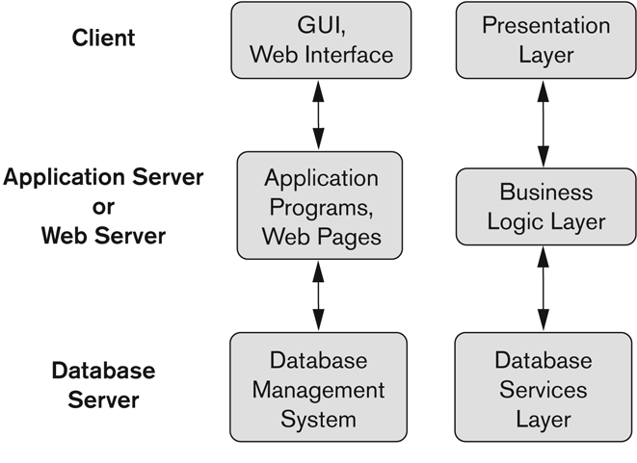
Significance of “Tiers”

Slide 22
The 3-Tier Architecture for Web Apps
Presentation Layer
Static or dynamically generated content rendered by the
browser (front-end)
Notes:
‹#›

Slide 23
The 3-Tier Architecture for Web Apps
Logic Layer
A dynamic content processing and generation level application server, e.g., Java EE, ASP.NET, PHP
Business logic acts as an interface between Client layer and Data Access Layer
All business logic – like validation of data, calculations, data insertion/modification are written under business logic layer.
It makes communication faster and easier between the client and data layer
Notes:
‹#›

Slide 24
The 3-Tier Architecture for Web Apps
Data Layer
A database, comprising both data sets and the database
management system or RDBMS software that manages and provides access to the data (back-end)
Notes:
‹#›

Slide 25
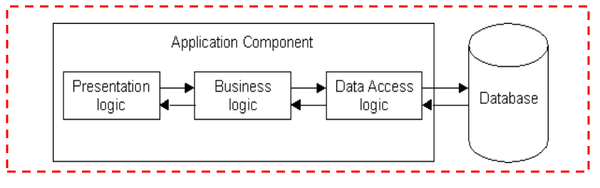
Significance of “Tiers”
Database runs on Server
Separated from client
Easy to switch to a different database
Presentation and logic layers still tightly connected
Heavy load on server
Potential congestion on network
Presentation still tied to business logic

Slide 26
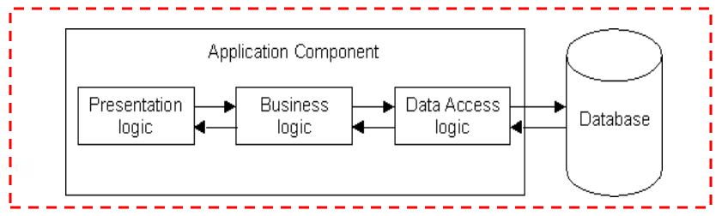
1-Tier Architecture
All 3 layers are on the same machine
All code and processing kept on a single machine
Presentation, Logic, Data layers are tightly connected
Scalability: Single processor means hard to increase volume of processing
Portability: Moving to a new machine may mean rewriting everything
Maintenance: Changing one layer requires changing other layers

Slide 27
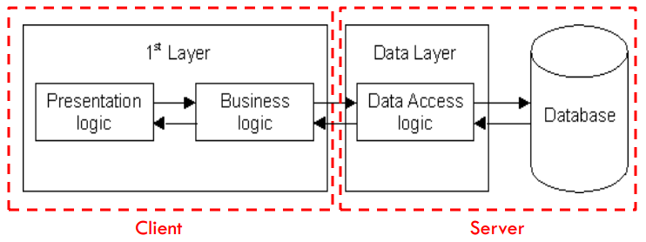
2-Tier Architecture
Database runs on Server
Separated from client
Easy to switch to a different database
Presentation and logic layers still tightly connected (coupled)
Heavy load on server
Potential congestion on network
Presentation still tied to business logic

Slide 28
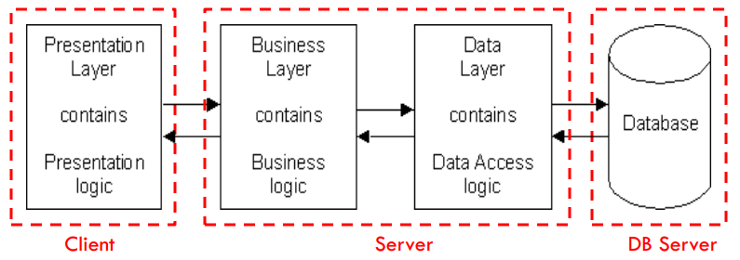
3-Tier Architecture
Each layer can potentially run on a different machine
Presentation, logic, data layers disconnected

Slide 29
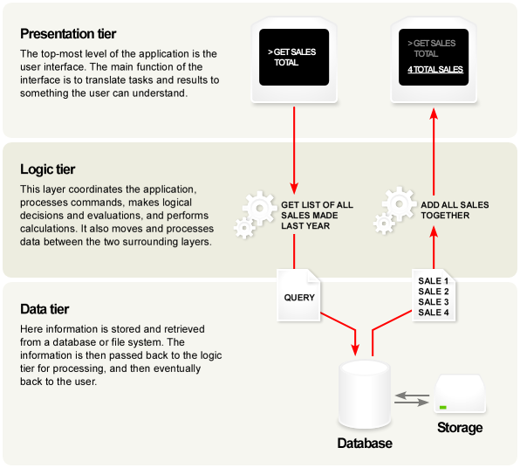
A Typical 3-tier Architecture
Architecture Principles
Client-server architecture
Each tier (Presentation, Logic, Data) should be independent.
Change in platform affects only the layer running on that particular platform

Slide 30
A Typical 3-tier Architecture
Presentation Layer
Provides user interface
Handles the interaction with the user
Sometimes called the GUI or client view or front-end
Should not contain business logic or data access code

Slide 31
A Typical 3-tier Architecture
Logic Layer
The set of rules for processing information
Can accommodate many users
Sometimes called middleware/ back-end
Should not contain presentation or data access code

Slide 32
A Typical 3-tier Architecture
Data Layer
The physical storage layer for data persistence
Manages access to DB or file system
Sometimes called back-end
Should not contain presentation or business logic code

Slide 33
3-Tier Architecture - Advantages
Independence of Layers
Easier to maintain
Components are reusable
Faster development (division of work)
Web designer does presentation
Software engineer does logic
DB admin does data model

Slide 34
Database Users
Users are differentiated by the way they expect to interact with
the system
Application programmers – interact with system through DML calls
Sophisticated users – form requests in a database query language
Specialized users – write specialized database applications that do not fit into the traditional data processing framework
Naïve users – invoke one of the permanent application programs that have been written previously
Examples, people accessing database over the web, bank tellers, clerical staff

Slide 35
Database Administrator
Coordinates all the activities of the database system; the database administrator has a good understanding of the enterprise’s information resources and needs.
Database administrator's duties include:
Schema definition
Storage structure and access method definition
Schema and physical organization modification
Granting user authority to access the database
Specifying integrity constraints
Acting as liaison with users
Monitoring performance and responding to changes in requirements

Slide 36
End

